Slide 1

TOMS BALTMUGUIRS
HOW OLIST CAN INCREASE REVENUE?
PAYMENTS / MONETISATION
ANALYST SPRINT

Slide 2
STRUCTURE
Installments
Top 16 categories
Overall outlook

Slide 3
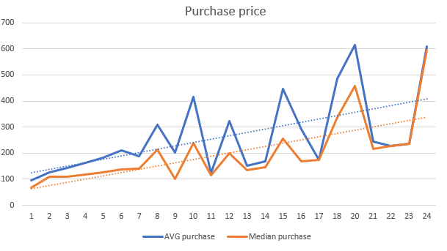
1) INSTALLMENT PAYMENT ANALYSIS
127.96 - Average purchase price without installments
Customers choose installments for more expensive purchases
Most expensive purchases - the longest timeframe taken
More customers are incentivized to buy at this store

Slide 4
Why should we care?

Slide 5
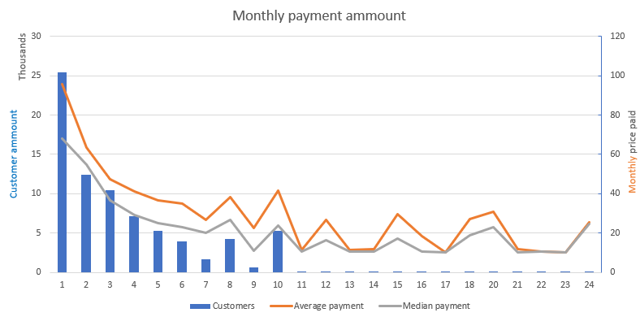
1) INSTALLMENT PAYMENT ANALYSIS
Increased stability for a business - less impact from seasonality
More stable cash flow - better terms for bank loans
A potential problem with installments longer than 10 months

Slide 6

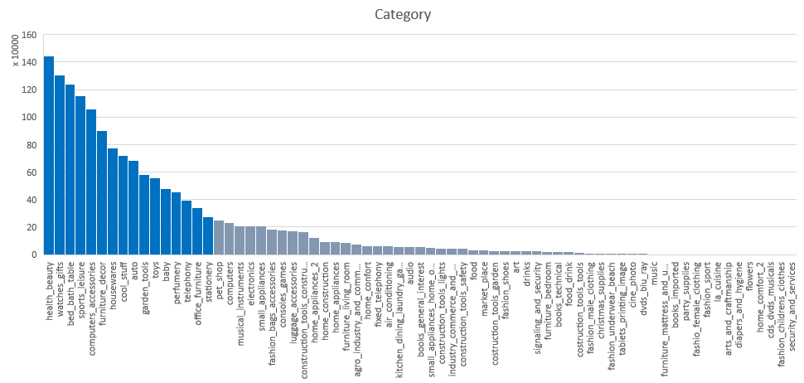
2) TOP 16 CATEGORY ANALYSIS
Analysis of the top 16 product categories, that are responsible for 80% of total companies' revenue.
Top 3 categories:
Health/beauty (9.22% of total)
Watches – gifts (8.35% of total)
Bed bath table (7.94% of total)
Notes:
Group by categories

Slide 7
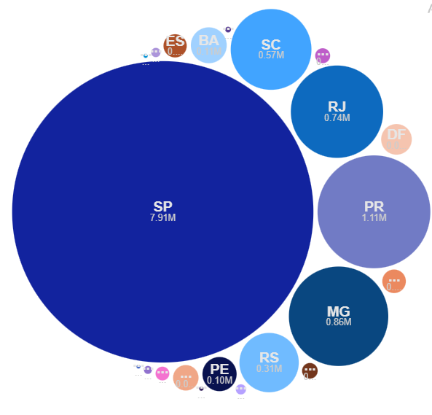
2.1) BIGGEST EARNER
São Paulo - 65% of revenue
Revenue over 1 Million from "Bed, baths, table" and "Watches - gifts" categories.
Some problems:
4th worst state in late deliveries
Most profitable categories: over 8% late deliveries.
Office furniture - Concerningly low review rate: 3.52
2nd lowest in average reviews.
Notes:
Listeners will compare – what do the rations mean

Slide 8









2.2) OPPORTUNITIES
1
2
3
4
Office furniture is sold from only 5 states: SP, SC, RJ, PR and MG.
90% of supply coming from SP.
Focus on finding producers close to SP.
"Bed, bath and table" and "office furniture" are worst reviewed products on average: introduce quality control or recruit professionals with some bonus system
The company earns from commissions. Focus on categories:
PB, RN, MA.
Offer these state sellers education on business.
Watches - gifts (214.44 $/purch)
Office furniture (193.67$/purch)
Cool stuff (177.35$/purch)
Focus on gaining workers from these states, since low activity there.

Slide 9
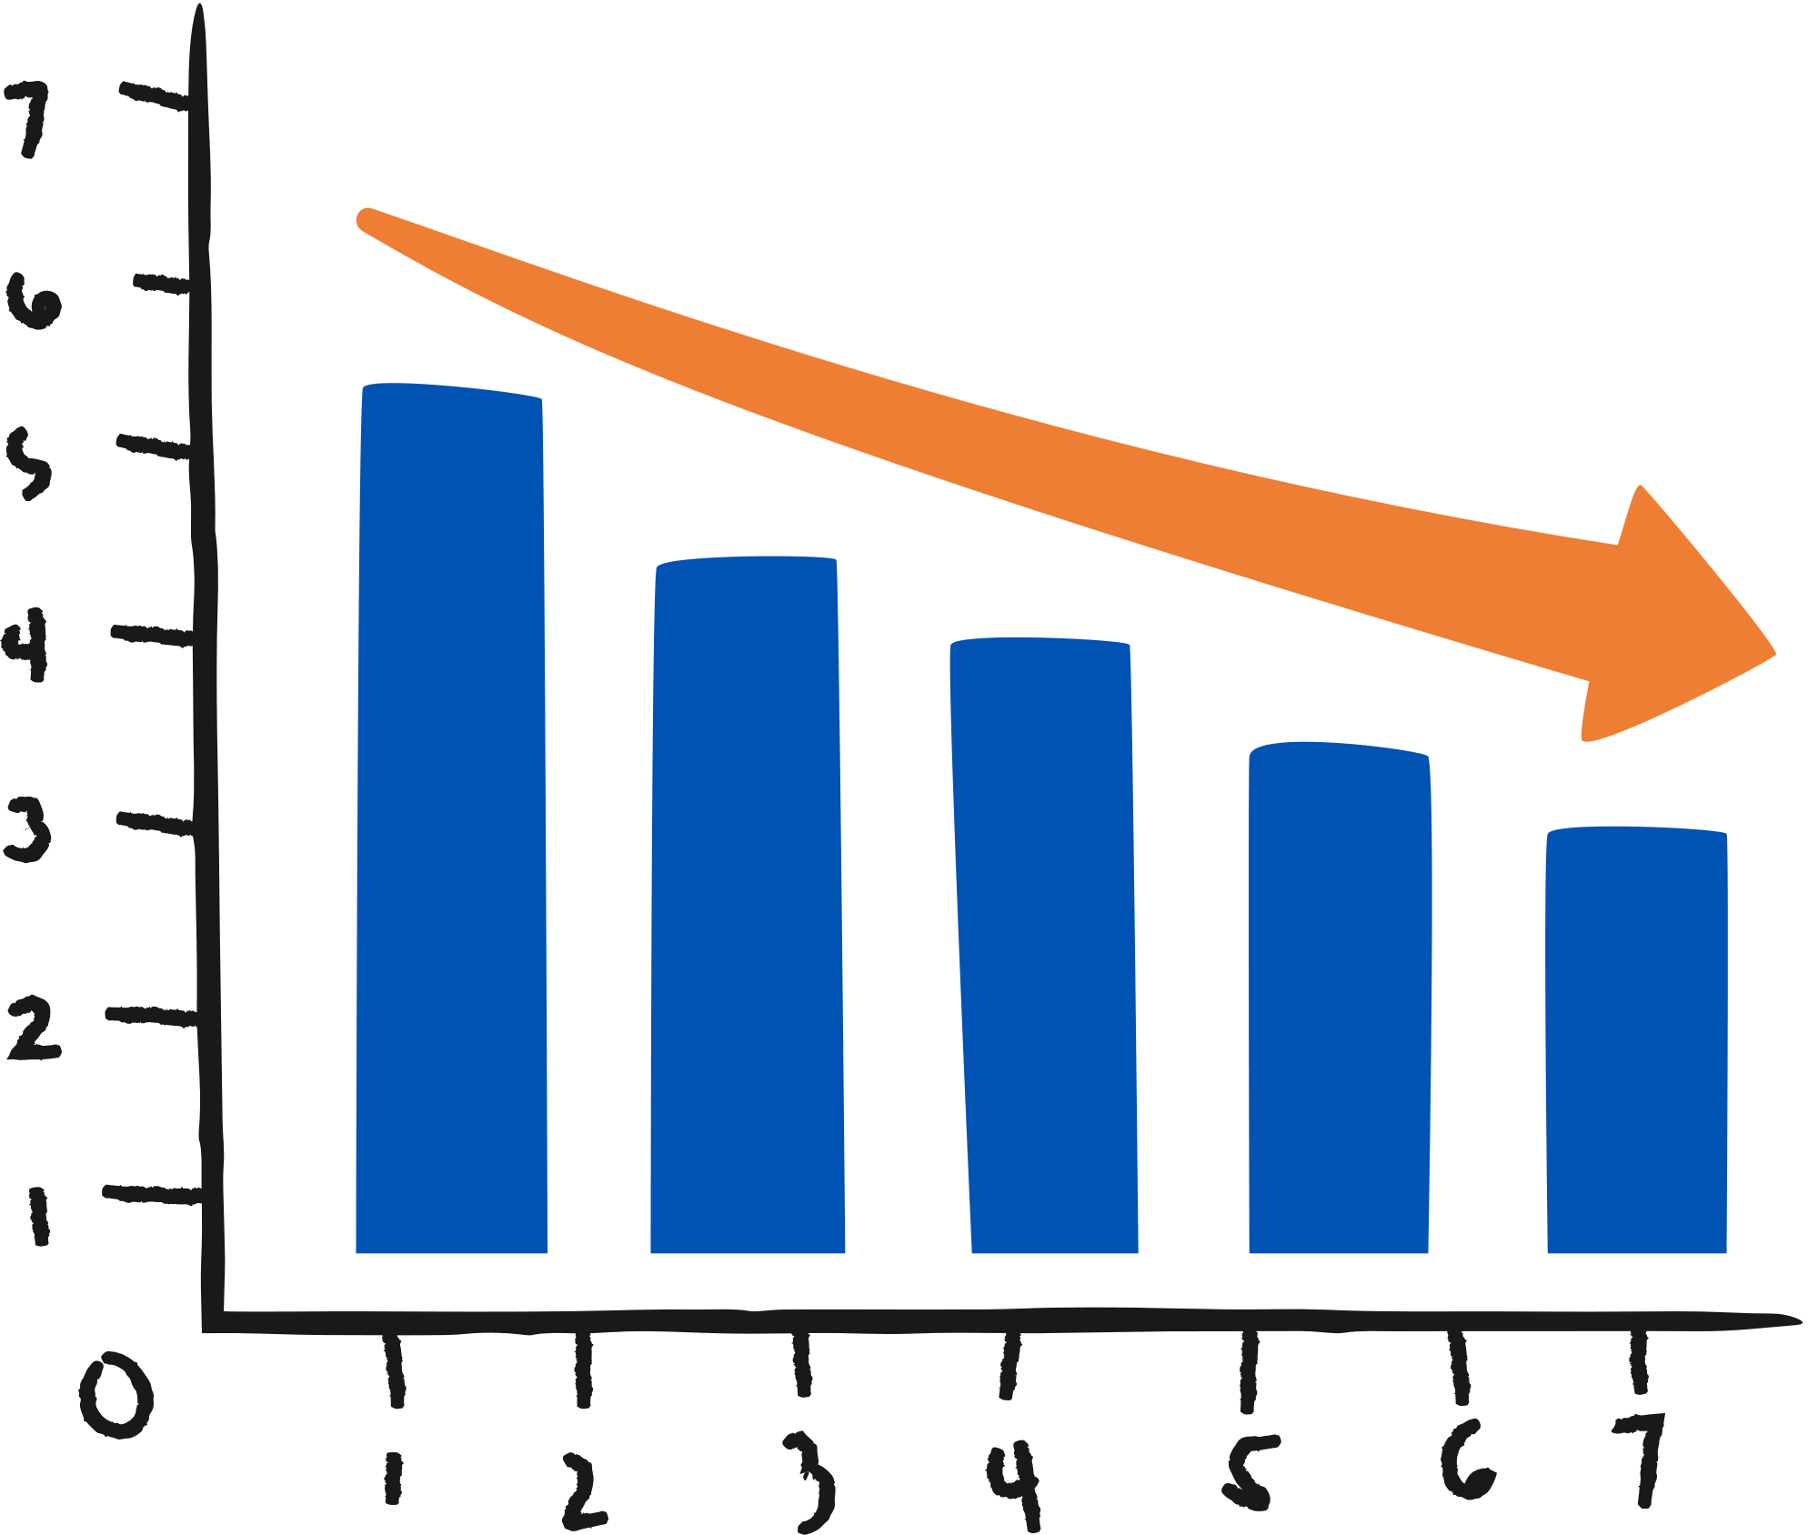

3) OVERALL OUTLOOK
Late deliveries + low review ratios
Fast deliveries + best review ratios
Worst categories:
Best categories
Audio
Home comfort
Furniture mattress & upholstery
Office furniture
Air conditioning
Construction tools
Market place
Worst cities:
Best cities:
Sao Luis
Foz do iguacu
Porto ferrira
Laramjal Paulista
Navegantes
Tres Rios
Aparecida de Goiania

Slide 10
MAIN CONCLUSIONS FOR BUSINESS
1
ENCOURAGE MORE PAYMENTS IN INSTALLMENTS
Stable cash flow for longer periods: increased inventory days, but more predictable cash flow.
2
LONGER PAYMENT INSTALLMENT AVAILABILITY
Make longer payment installments available, but an interest rate system is needed. (Interest rate should be added if payment stretched out for longer than 10 months)
3
MORE WORKFORCE OR WAREHOUSES CLOSER TO SAO PAULO
Late delivery time needs to be decreased to provide the best service. Investment in logistics needed.

Slide 11
MAIN CONCLUSIONS FOR BUSINESS
4
MOST BOUGHT CATEGORIES NEED TO BE PRIORITY
The "Bed, bath and table", "Health beauty" and "furniture decor" category needs to have a lower late delivery ratio than 8% since they are the products that represent the brand most often.
5
OFFICE FURNITURE SELLERS CLOSE TO SP NEEDED
Sao Paulo has the largest demand, but outside SP state there could be a cheaper workforce: more incentive to sell at same prices. Company needs to increase marketing to nearby states.
6
WORST VS BEST PRACTICES
The company quickly needs to focus on its worst-rated categories and cities. Some masterclasses should be organized. Additionally, the company should focus on logistics for bad performing cities

